Slide 1


Analysis of the connectivity of hydrides within the microstructure of Zr alloys
Research Software Engineering Practice
Group 2
Wunmi Olukoya, Jamie McGregor, Enn Veikesaar and Laura González Duque
03/06/2021

Slide 2
Content
Utilisation of git repository
Image processing in Python
Determining connectivity
Creation of functions in the code
Testing of the code
Written report

Slide 3
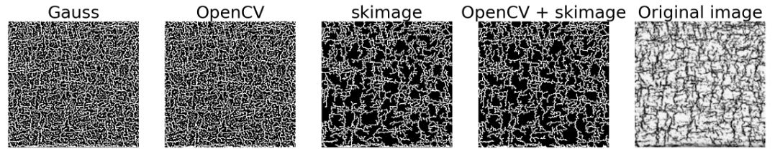
Image processing - Gaussian thresholding
Adaptive Gaussian thresholding - poor results
Noise removal necessary, but results are inconsistent
Notes:
Aluminium alloys are among the most worldwide demanded alloys and their demand grows every year because they count on many advantageous characteristics, being the principal their low density and low price, especially of interest in the vehicle sector. The European Aluminium association estimated a 40% growth in demand for aluminium between 2019 and 2050. Aluminium sheets are the most popular way of use of this material and they are widely employed in many relevant sectors because they can be cut and formed into different desired shapes. Therefore, there is a strong incentive to optimise the performance of this product and competition in the market is very strong.

Slide 4
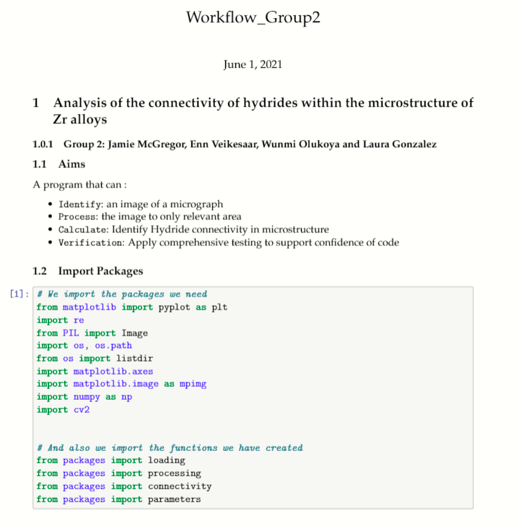
Creation of functions in the code
Structure of the demo notebook
Import packages
Import images
Image processing
Thresholding
Connectivity
Notes:
Once the code has been developed, we introduce our code into functions, and we create a demo notebook to show the user how to use the functions.
We used Jupyter to write it, and we structured it with these sections listed on the right, which includes the packaging importing to import all the packages needed (the python modules and the modules that we created with our own code), the import of the image we are going to process, the image processing and finally the thresholding and connectivity calculation and plotting.

Slide 5
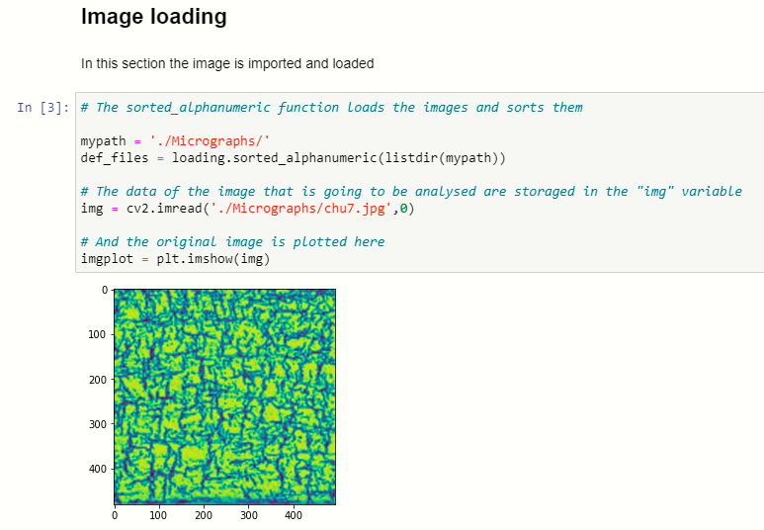
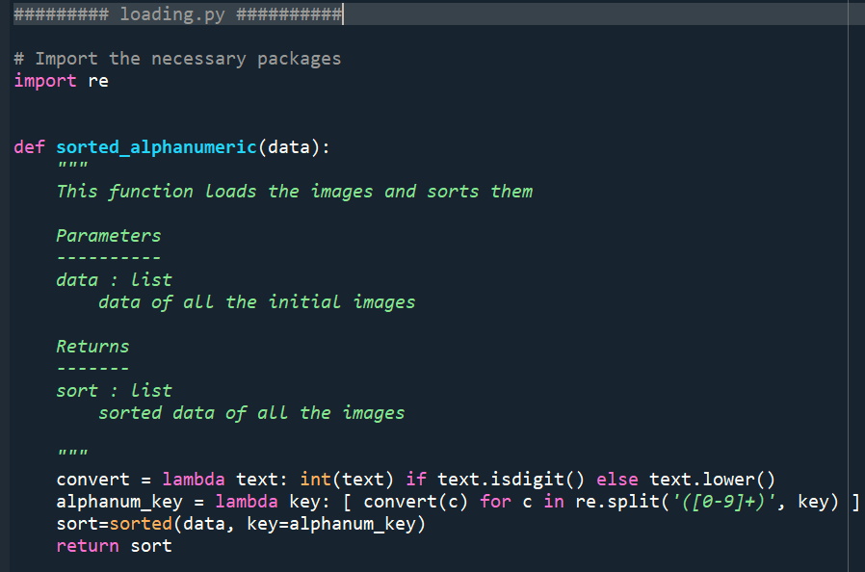
Creation of functions in the code
Description
Calling the function
Plotting the result
Notes:
In each section we describe briefly at the beginning what is going to be done in the section. Then, we call a function that has been stored on a .py file. And finally we plot the result.
Here in the right part of the slide we can see an example of one .py document. All the .py documents have the same structure. We import the needed packages first, then we define the name and inputs of the function or functions with their corresponding descriptions at the beginning, their code and finally their return.

Slide 6

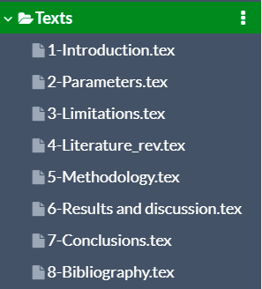
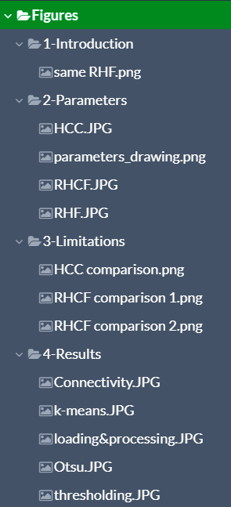
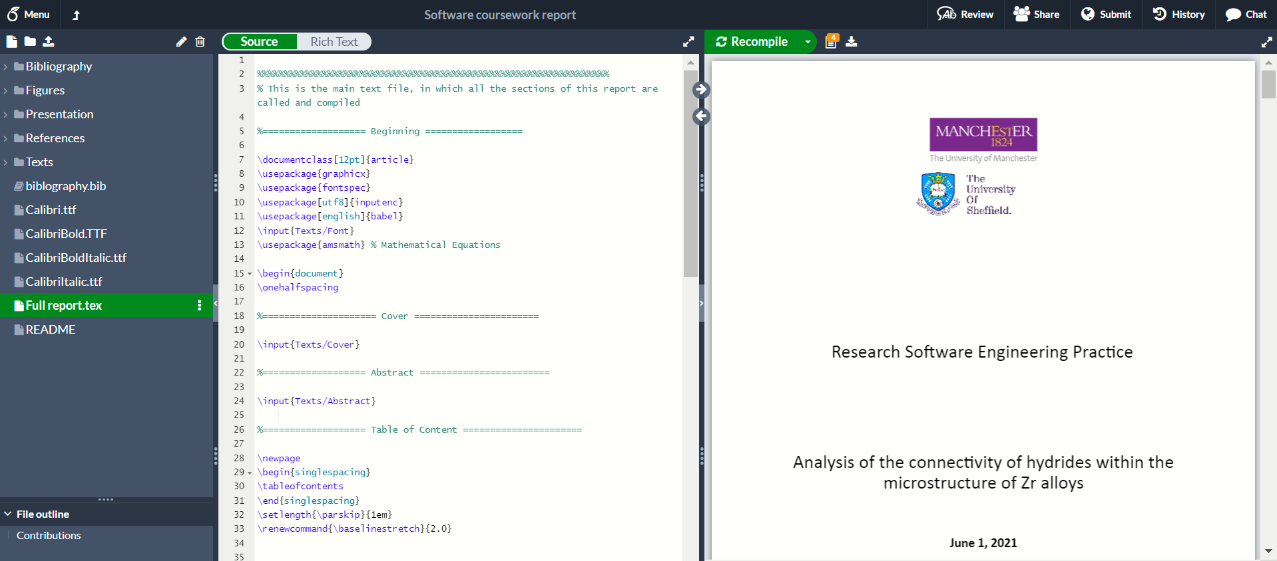
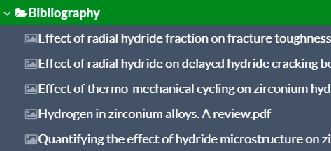
Written report
Notes:
To write the report as a latex document we used the editor Overleaf. Here you can see how it looks like and how we divided the content of the report into different folders, tidying the images and sections into different folders and subfolders.

Slide 7
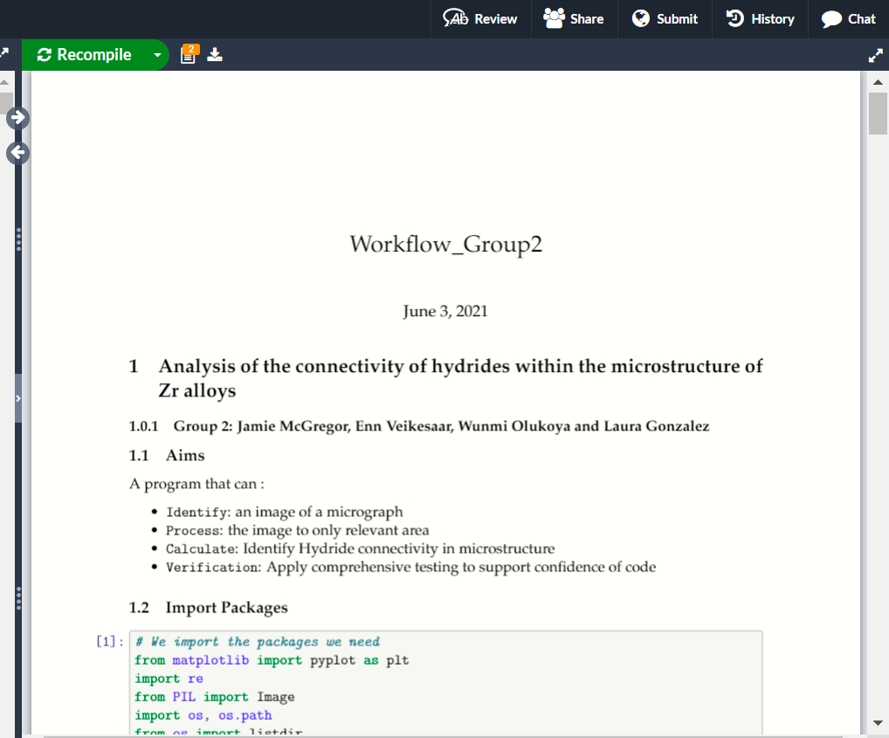
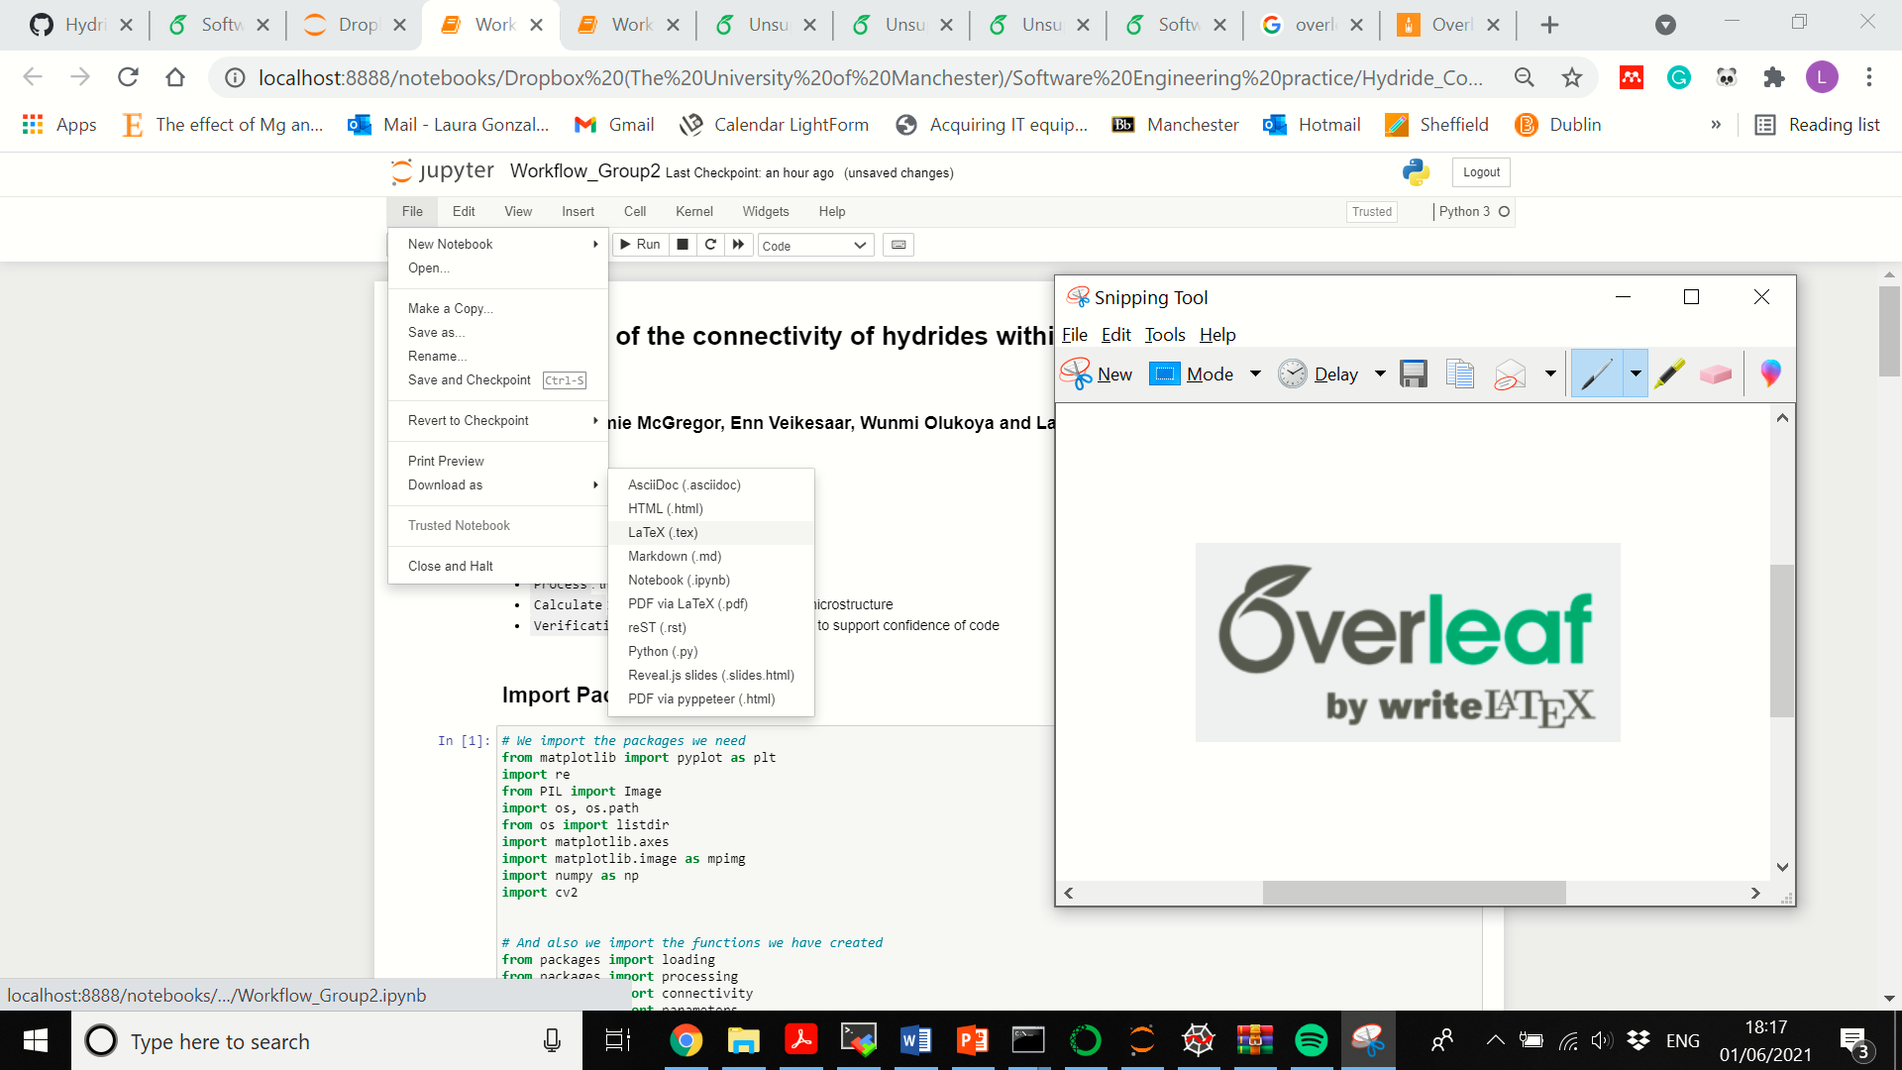
Written report
Notes:
One thing that we discovered is that our Jupyter notebook can be saved as a latex file too, so we can add our coding to the report avoiding copy and paste manually when we want to introduce part of the code in the report.

Slide 8
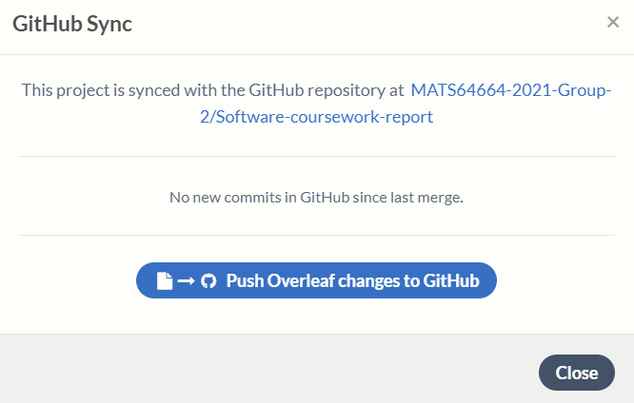
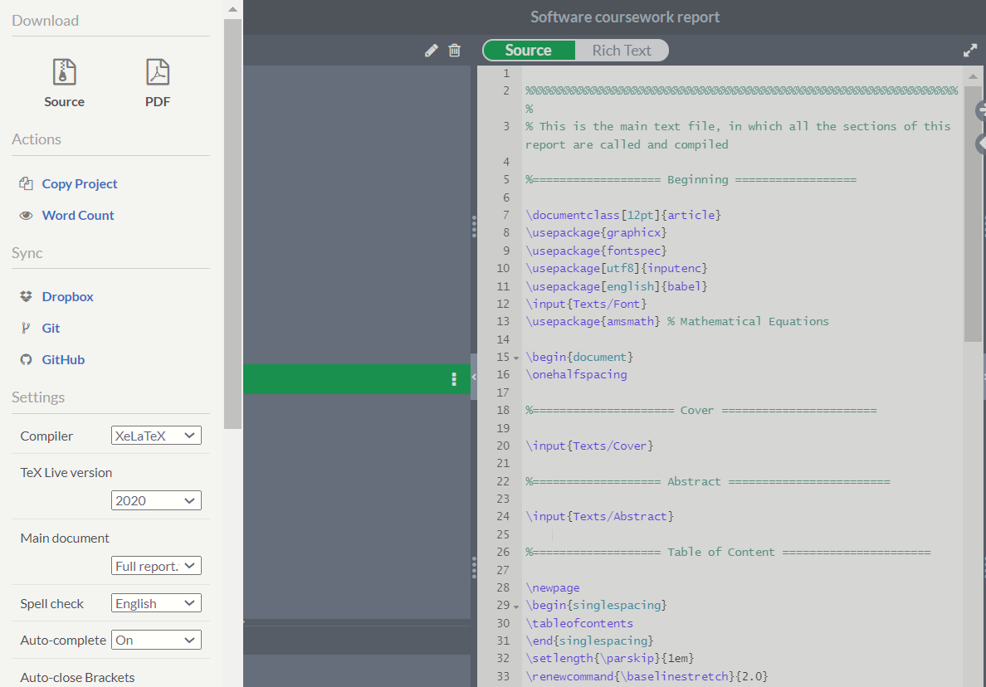
Written report
Notes:
About the version control, we can push our changes directly from Overleaf to GitHub by clicking on the GitHub option in the menu.

Slide 9
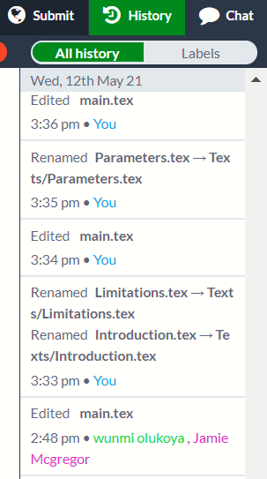
Written report
Notes:
But Overleaf has its own system to track the changes and the authors of the changes too. You just need to click here, on the History button, and you can restore old versions or just see the changes that were made.

Slide 10
Thank you

